Slide 1
Swiss SARS-CoV-2 Re comparison
Hodcroft et al (Nature, 2021) vs. Nadeau et al (in prep)

Slide 2
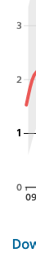
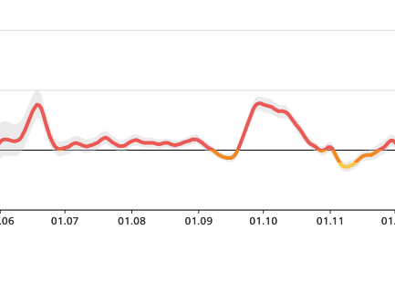
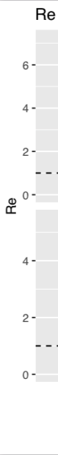
Hodcroft et al:
No Swiss down-sampling: all available sequences
OU prior on sampling proportion
Nadeau et al:
Down-sampling to max. 5% of cases per Canton-week
OU (not shown) or piecewise-constant (here) prior on sampling proportion
Discrepancy: compared to confirmed-case base estimates (top) Re in Hodcroft et al. (bottom) roughly matches but in Nadeau et al. (middle) dips unrealistically in mid-October
We include more of our prior information in Nadeau et al – is there any way this Re dip could be real?
Or, Tim asks, is there a decrease in diversity that explains the dip/spike in sampling proportion trade-off?
Notes:
Re spikes in late October across all analyses but this is more exaggerated than we expect in the Nadeau et al. analysis

Slide 3
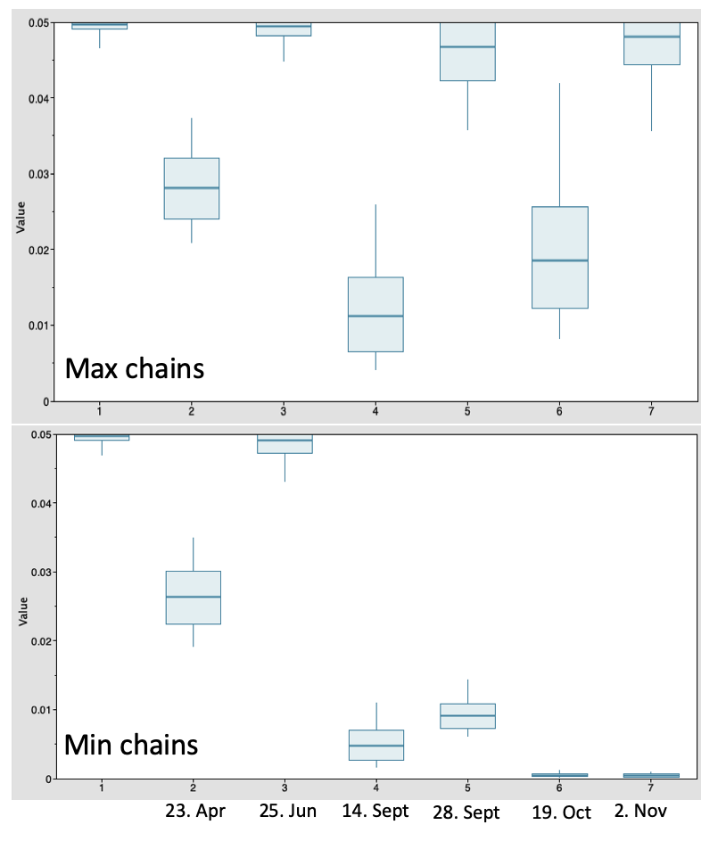
In Hodcroft et al. we include max. 1724 samples from Oct. and estimate sampling proportion 0.1 – 0.15 → 11 – 17,000 infections in month of October
In Nadeau et al. we include 546 samples from 28.09 – 19.10 and estimate sampling proportion 0.01 – 0.05 → 11 – 54,000 infections in the 3-week period end Sept – mid Oct
2020-04-23 = all symptomatic individuals can get tested 2020-06-25 = gov't pays for tests for symptomatic individuals 2020-09-14 = genome sampling falls much below 5% of confirmed cases 2020-09-28 = the number of tests conducted and % positivity dramatically increase in Switzerland, genome sampling also increases 2020-10-19 = genome sampling falls much below 5% of confirmed cases again 2020-11-02 = genome sampling improves again
Notes:
Focusing on plausible number of infections in October:
Nadeau et al:
Min chains: 19.10 – 2.11: 515 samples / 0.001 sampling proportion = ~500,000 infections within 2 weeks
Max chains: 19.10 – 2.11: 515 samples / 0.02 sampling proportion = ~25,000 infections within 2 weeks
Hodcroft et al:
?? We binned sequences by month right?
Min chains: October: 1724 samples (?) / 0.1 sampling proportion = ~17,000 infections within 1 month
Max chains: October: 1724 samples (?) / 0.15 sampling proportion = ~11,000 infections within 1 month
Corona immunitas results through Dec 2020: ~20% of 8,500,000 inhabitants infected thus far = ~1,700,000 infections within 1 year (average of ~140,000 per month)
So Hodcroft estimates might be a bit low and Nadeau estimates range from potentially a bit high to way too high.

Slide 4
Number of samples and mean chain size across weeks for min/max analyses in Nadeau et al. and Hodcroft et al.
BAG confirmed case-based Re estimates
Nadeau et al. Re estimates
Hodcroft et al. Re estimates
The down-sampling based on confirmed cases shows the double spike in rise of cases with dip in between, just as Re estimates do.
The actual confirmed cases show a clean rise between 1.10 and 1.11.
The confirmed case estimates don’t show a dip-then-spike but otherwise lie between the Hodcroft and Nadeau et al. estimates

Slide 5
The inferred sampling proportion does actually follow what we expect, and is lower in periods where genome sampling is lower: 14.09 – 28.09 and 19.10 – 02.11 (blue rectangles)
2020-04-23 = all symptomatic individuals can get tested 2020-06-25 = gov't pays for tests for symptomatic individuals 2020-09-14 = genome sampling falls much below 5% of confirmed cases 2020-09-28 = the number of tests conducted and % positivity dramatically increase in Switzerland, genome sampling also increases 2020-10-19 = genome sampling falls much below 5% of confirmed cases again 2020-11-02 = genome sampling improves again

Slide 6
Previous approaches and results
03.06: Alignments generated with empirical sampling prop upper bound 0.05 and sampling at cantonal level.
Tim adjusted Re change times (to match down-sampling week breaks), sampling change times (to follow major policy changes). Sampling proportion upper bound is 1%. Double-spike in Re in the second wave still there:
3
09.03: Alignments generated with empirical sampling prop upper bound 0.01.
Tim imposed an upper bound of 0.1 on sampling proportion. Origin time prior lognormal?
1
31.03: Alignments generated with empirical sampling prop upper bound 0.01.
Tim adjusted sampling proportion and origin priors (sampling rate upper bound lowered and a uniform origin time prior). The new priors seem to add an additional spike to the Re skylines:
2
07.06: Same alignments as 03.06.
Tim added sampling change times for sequencing changes and sampling proportion upper bounds (5%). Double-spike in Re in the second wave lesser but there still:
4
Notes:
I like imposed sampling proportion upper bound because it enforces our prior info and helps capture Re decrease in March (1 -> 2).
Matching Re change times to empirical sampling change times didn’t help (2 -> 3).
Raising the sampling proportion upper bound from 1% to 5% reduced the Re dip (3 -> 4).
Further evidence that double-spike eliminated by high sampling proportion is Hodcroft et al. analysis in which sampling proportion approaches 0.1 – 0.15 and there’s no double-spike.
Now I’m confused what to do, because we really do believe in the 5% upper bound based on confirmed cases. Given that we don’t want to change the sampling proportion prior, shall I change the sampling scheme again? I.e. take cases from adjacent cantons or across Switzerland to fill in samples for under-sampled weeks?

Slide 7
Sensitivity tests and results
14.06: Same alignments as 03.06.
Tim changed origin prior back to log-normal. Qualitative changes in Re skyline but Re double-spike remains:
5
14.06: Same alignments as 03.06.
Tim kept uniform origin prior but lifted the upper bound on the sampling proportion. Re double-spike eliminated (compare to results for Hodcroft et al).
6
Sampling proportions, most recent to oldest:
7 = from start = mostly only risk groups, exposed get tested
6 = 2020-04-23 = all symptomatic individuals can get tested 5 = 2020-06-25 = gov't pays for tests for symptomatic individuals 4 = 2020-09-14 = genome sampling falls much below 5% conf. cases 3 = 2020-09-28 = # tests. % positivity inc., genome sampling inc. 2 = 2020-10-19 = genome sampling falls much below 5% conf. cases 1 = 2020-11-02 = genome sampling improves again

Slide 8
I am becoming convinced we get an unrealistic Re double-spike in late fall unless we allow the sampling proportion to spike (>~0.1) around this time.
This could be because, despite the fact that the empirical sampling proportion is fairly constant, the second, unrealistic Re spike
corresponds to a spike in absolute samples around the week of 4. Nov.
Note that the dataset for EH’s paper does not have this spike – it is an artefact (for better or worse) of down-sampling proportional to confirmed case counts. Correspondingly, the analysis for EH is the only one in which we’ve avoided the second Re spike without allowing a spike in the sampling proportion towards the present (after 2. Nov).
Proposal is that the spike in genome samples is artefactual, possibly because I sum confirmed cases in 1-week bins. More appropriate could be taking a rolling average of confirmed cases with a window width of 2 weeks.
For quick turn-around, I’ll just lower the sampling proportion a bit and try to down-sample from within the current alignment (keep the same clusters).

Slide 9
New truncated alignment, upper bound at 0.05 and sampling proportion change times
07.06: Same alignments as 03.06.
Tim added sampling change times for sequencing changes and sampling proportion upper bounds (5%). Double-spike in Re in the second wave lesser but there still:
4

Slide 10
Does the sampling profile look a lot better if I smooth the confirmed case counts?
Smoothed across 3-week left-centered interval for each canton – sampling profile looks worse in spring.

Slide 11
01.07 From a gently modified sampling scheme (truncated one week) but otherwise same as main analysis
2020-04-23 = all symptomatic individuals can get tested
2020-06-25 = gov't pays for tests for symptomatic individuals
2020-09-14 = genome sampling falls much below 5% of confirmed cases
2020-09-28 = the number of tests conducted and % positivity dramatically increase in Switzerland, genome sampling also increases
2020-10-19 = genome sampling falls much below 5% of confirmed cases again
2020-11-02 = genome sampling improves again
15.06 From the analysis with no sampling proportion upper bound
Why would the most recent sequences have such a high sampling proportion? Are they less diverse?

Slide 12
Sampling proportions, most recent to oldest:
BAG confirmed case-based Re estimates
Our Re estimates (5% upper bound sampling proportion)
7 = from start = mostly only risk groups, exposed get tested
6 = 2020-04-23 = all symptomatic individuals can get tested 5 = 2020-06-25 = gov't pays for tests for symptomatic individuals 4 = 2020-09-14 = genome sampling falls much below 5% conf. cases 3 = 2020-09-28 = # tests. % positivity inc., genome sampling inc. 2 = 2020-10-19 = genome sampling falls much below 5% conf. cases 1 = 2020-11-02 = genome sampling improves again
Hodcroft et al. Re estimates
Our Re estimates (no upper bound sampling proportion)

Slide 13
Is there a drop in sequence diversity that explains why the sampling proportion needs to go high ~ Nov 2 for Re to be reasonable in Nov?
→ Yeah, sort of?

Slide 14
Can we disentangle possible Summer vacation super-spreading vs. contact tracing in CHE by looking at another country where travel + possible super-spreading upon return doesn’t coincide with contact tracing?
H1: NZL CT stronger after 15 May than before → T
H2: NZL CT after 15 May stronger than CHE summer → F, =
The contact tracing factor does track case numbers/ expected success of contact tracing efforts in CHE and NZL.
Max chains early in pandemic don’t give signal.
Not impossible to rule out that other factors (super-spreading tourists or quarantined/travelling together people) contributed to higher early transmission rates in both countries during periods of low case numbers.
Take-home is still that recent introductions contribute more cases and countries are successful in limiting their spread when overall cases are low. --> argument for keeping cases low?

Slide 15
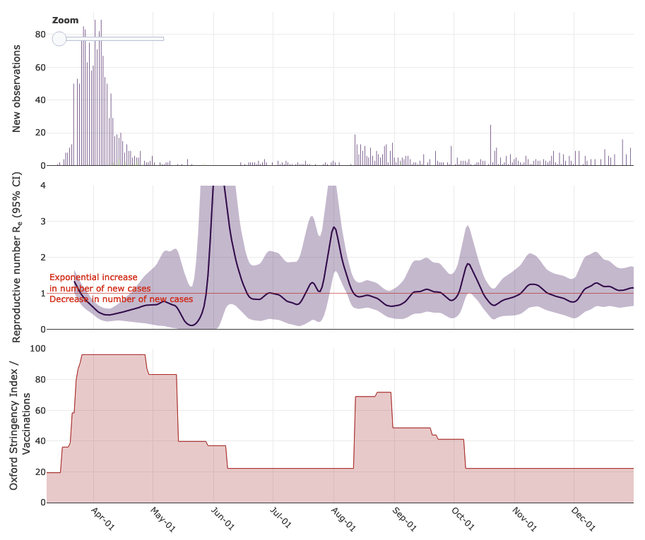
Major features of NZL epidemic:
National lockdown:
25 Mar – 27 Apr
→ initial Re decrease apparent
Long periods without community transmission (source: Wikipedia):
1. May – 11. Aug
25. Sept – 21 Oct
12 Nov – end year
Re should be informed only by quarantined-together/travelled-together transmissions during these periods
After national lockdown, Re only goes above 1 in a period around when community transmission happened (mid-October)
https://ibz-shiny.ethz.ch/covid-19-re-international/
Blue shows Re before contact tracing in model with damping factor,
red shows Re without any damping in model

Slide 16
Does it matter to split by introduction?
Not that much actually.

Slide 17
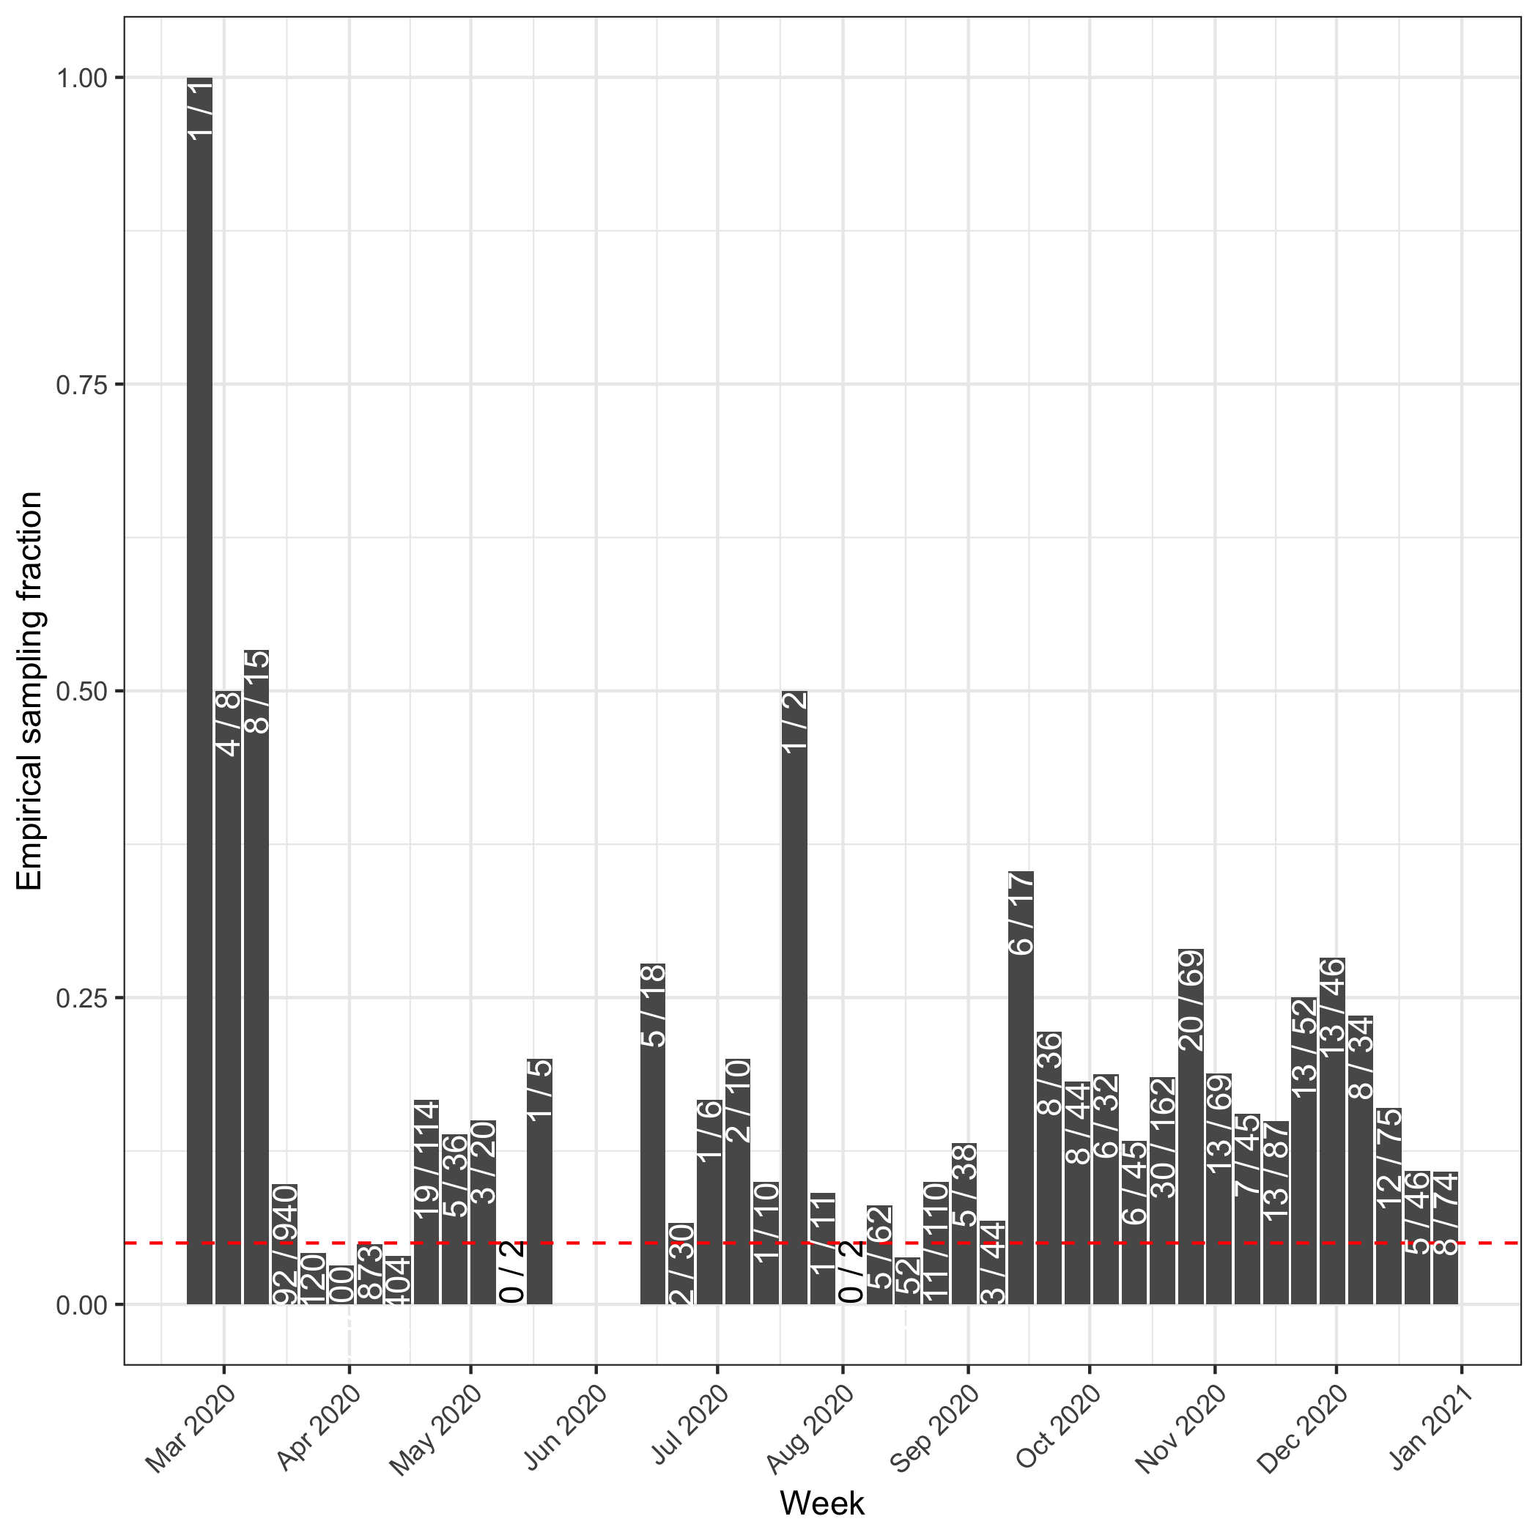
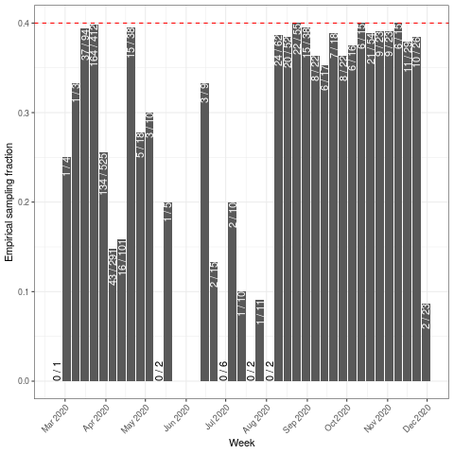
Comparison between older and newer runs
CHE results are consistent across new draw of samples under same sampling scheme and a small fix to context sequence set choosing.
NZL results are not consistent before May 15 across different sampling schemes.
The sampling scheme we like (constant through time relative to cases) gives results that don’t support our hypothesis (stronger damping in Spring than Summer - Fall)
Summer - Fall damping in NZL still comparable or lower than Summer damping in CHE
 | Plot set A | Plot set B
NZL sub-sampling | All samples | Upper-bound sampling to 40% of weekly cases
context sequences | Potentially missing related sequences under a Pango alias | Including most related sequences within Pango lineage
sample set draw | Random draw A | Random draw B
damping factors, conditional on inclusion
NZL: % cases analyzed by week
CHE: damping factor min/max (bottom/top); spring/summer/fall (left/middle/right)
NZL: damping factor min/max (bottom/top); before/after 15. May (left/right)
Re, without sampling proportion upper bound
CHE: Re through time min/max chains (bottom/top); no damping/un-damped (red/blue)
NZL: Re through time min/max chains (bottom/top); no damping/un-damped (red/blue)
Notes:
Where to go from here?
Are the Swiss results robust to inclusion of second deme?
Can we have some tree samples to look at these events?
Are the Swiss results robust to different sampling scheme?
We’re premised that we see polytomies in the trees. Premise: I’m stuck explaining the switch in NZL and would go back to the trees to see if the signal is really not there or some other thing balances it out.
What trees do we want?
Chain size: 1 - 315
Chain longevities: 1 day – 8 months
Need metric of burstiness or way to visualize burstiness
Get Tim the indices to log: chains that fall into and span the timeperiods of interest

